Slide 1
Swiss Ranks
Technical Round II – Assignment
R . Ajay
MSc Software Systems
Coimbatore Institute of Technology

Slide 2
Data Visualization
Problem Statement:
For given sample data create an User Interface(UI) to visualize given data by means of various Visualization Techniques.
UI can be created using any IDE , tools and technologies(independent of any restrictions)

Slide 3
Tools and Technology
Language Used: Python(backend) , HTML5(frontend).
Database Used: SQLite3.
IDE Used : Anaconda .
Web -
Framework: Flask.
Templates engine: Jinja.

Slide 4
Database
Given Database Structure
Name | Type
Parts Id | Varchar
Status | Varchar
Mat Category | Varchar
Part Name | Varchar
Created By | Varchar
Approve/Reject By | Varchar

Slide 5
Database
Normalized Database Structure
Name | Type
Parts Id | Varchar [Primary Key]
Status | Varchar
Mat Category | Varchar
Part Name | Varchar
CreatedEmpId | Integer [Foreign Key]
Approve/Reject EmpId | Integer [Foreign Key]
Name | Type
EmpId | Integer [Primary Key]
EmpName | Varchar
Department | Varchar

Slide 6
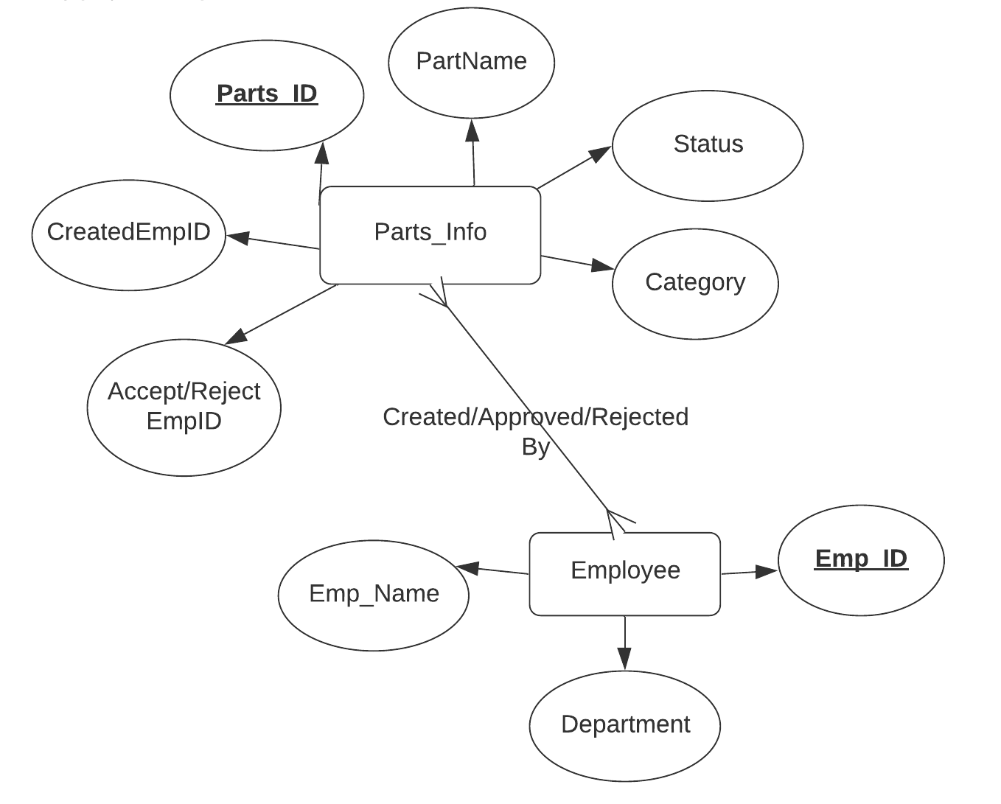
Database
Entity Relation Representation:

Slide 7
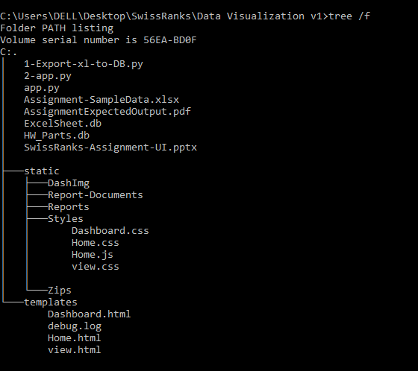
Design
Folder View:

Slide 8
Design
Python files
1-Export-xl-to-DB.py: To Export the data in Excel sheet to SQLite3 database and to normalize the given table.
2-app.py: It contains python code primarily for backend processing of data from Database
HTML files –Template Folder
Home.html: Home page contains of Data Visualization description
Dashboard.html: It allows user to place query or request and obtain results in any visual form[eg: Pie chart , bar chart etc...]
view.html: Its actually an template file created using jinja, used to diaplay table contents.

Slide 9
Design
Static Folder:
DashImg: Folder contains image sources used in Home page
Report-Documents: Folder contains generated charts collection in the form of word document.
Styles: It Consists of collection of CSS and JS source files for Html Files.
Zip: Folder consists of collection of Zip files which contains individual
.png images of charts generated at every session.
Database files:[SQLite3]
ExcelSheet: Contains data Extracted from given Excel document
HW_Parts: Contains Normalized tables obtained from ExcelSheet.db

Slide 10
Screen Shots of Assignment
The following slides contains the Screen Shots of User
Interface Developed, In a sequence in which user can
interact with system :-

Slide 11
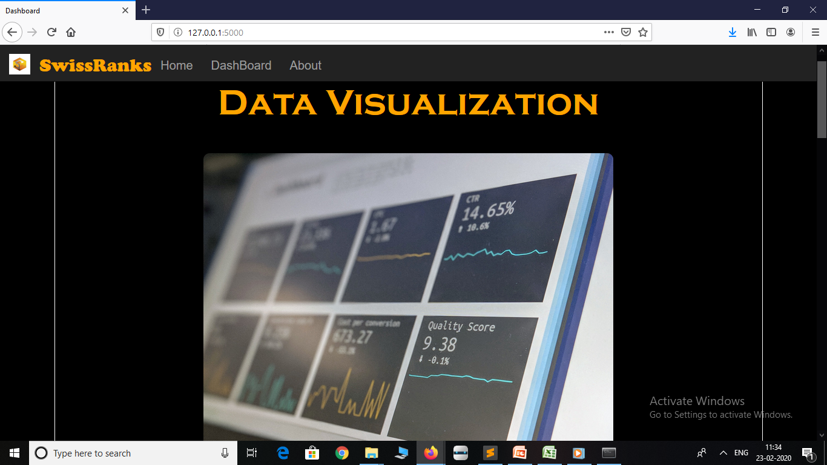
Screen Shots
Home Page - Home

Slide 12
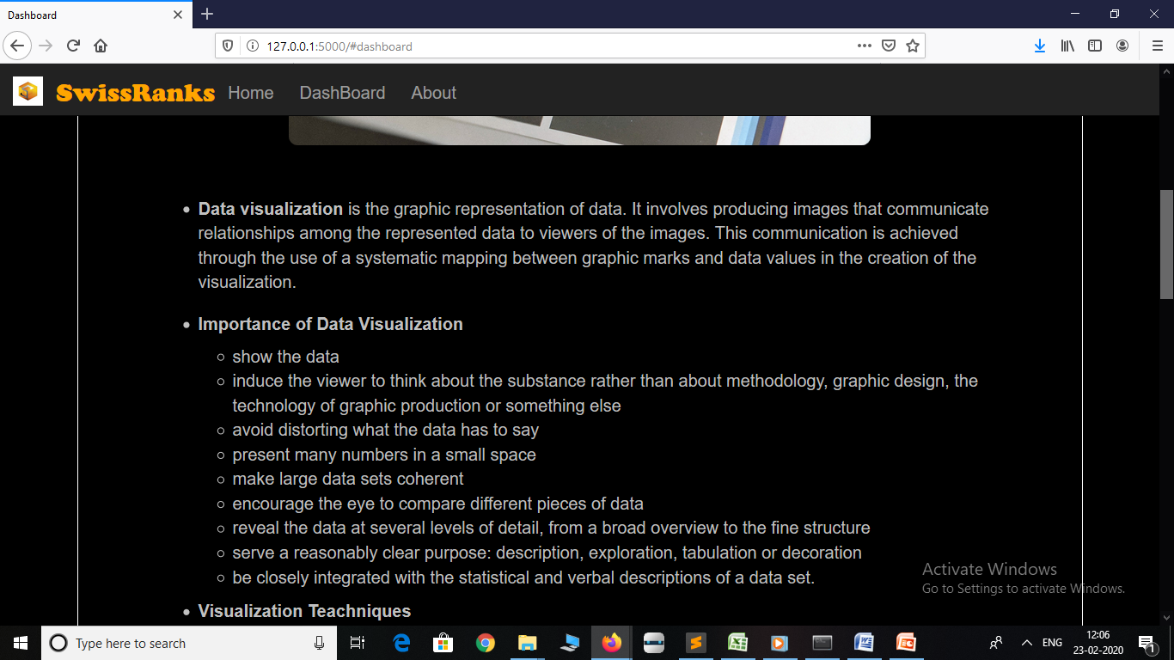
Home Page -> Home

Slide 13
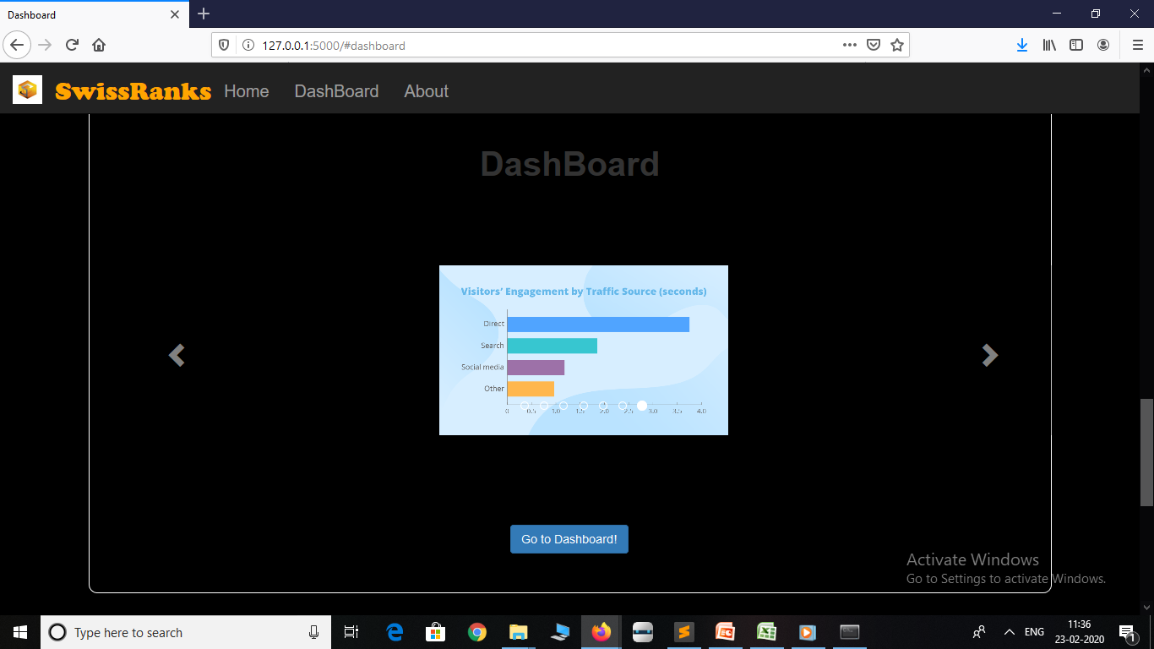
Home Page -> Dashboard

Slide 14
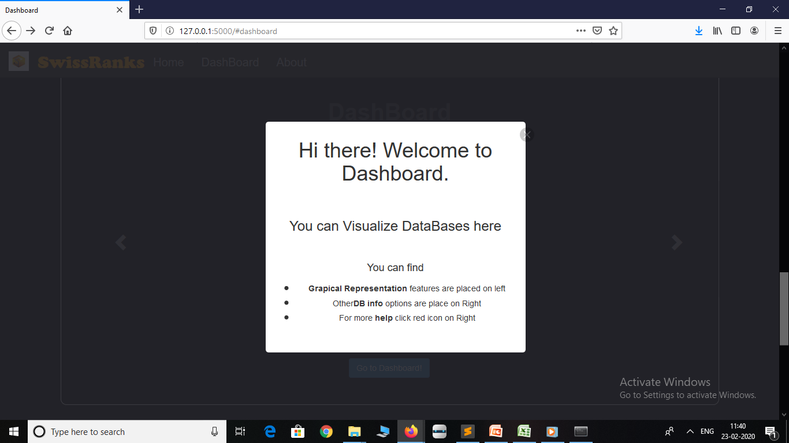
Dashboard Page -> Info(pop up)

Slide 15
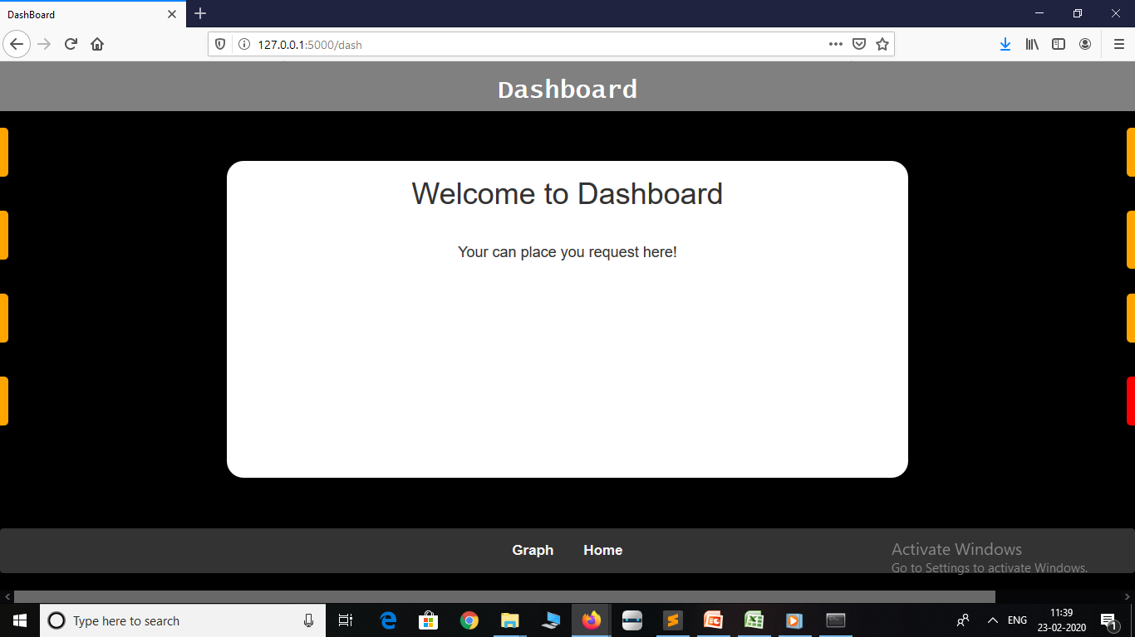
Dashboard Page -> Dashboard

Slide 16
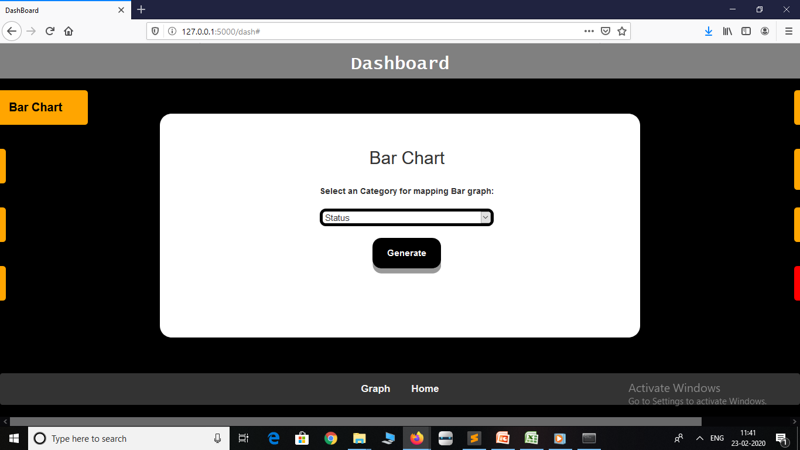
Dashboard Page -> Bar chart

Slide 17
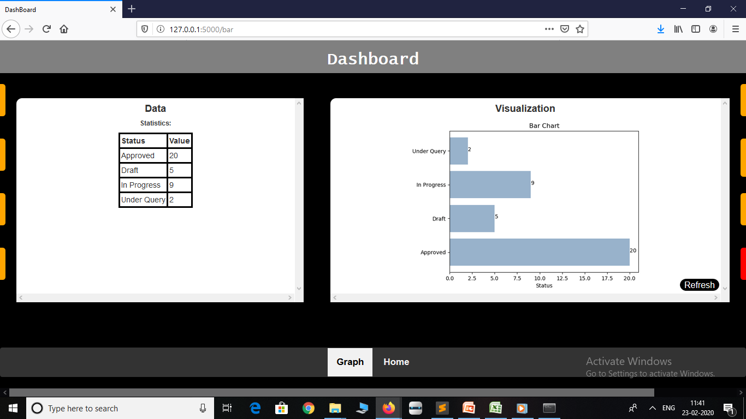
Dashboard Page -> Bar chart Visualization

Slide 18
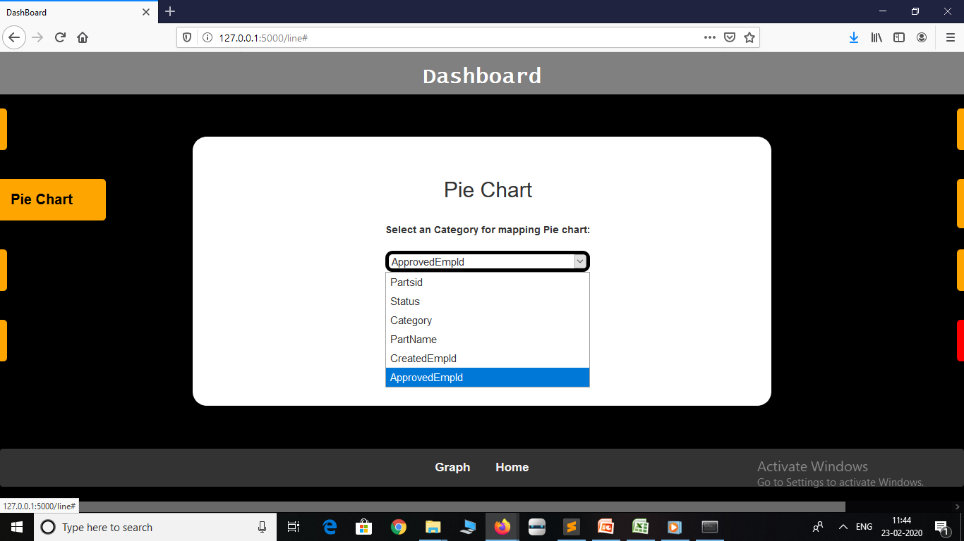
Dashboard Page -> Pie chart

Slide 19
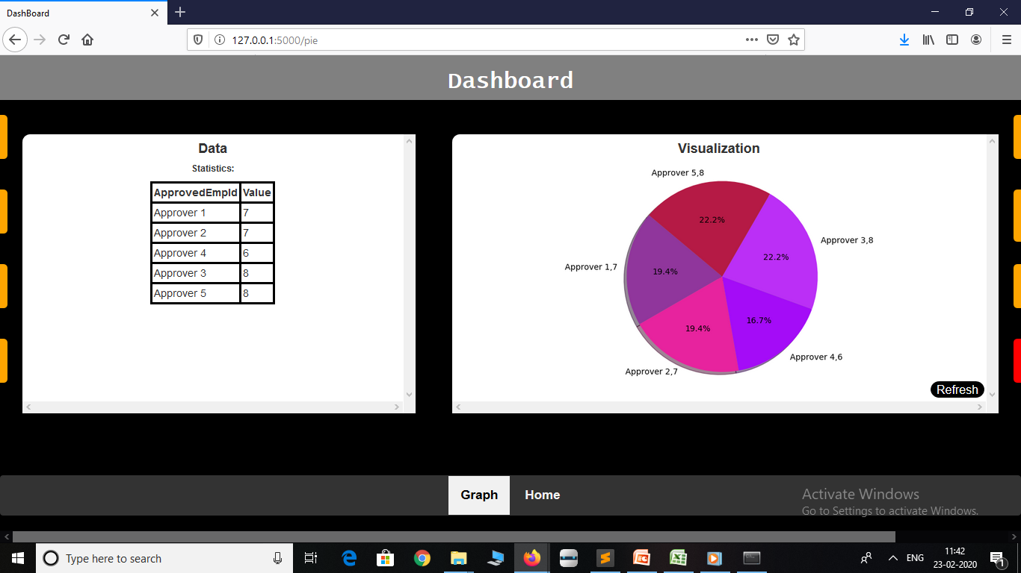
Dashboard Page -> Pie chart Visualization

Slide 20
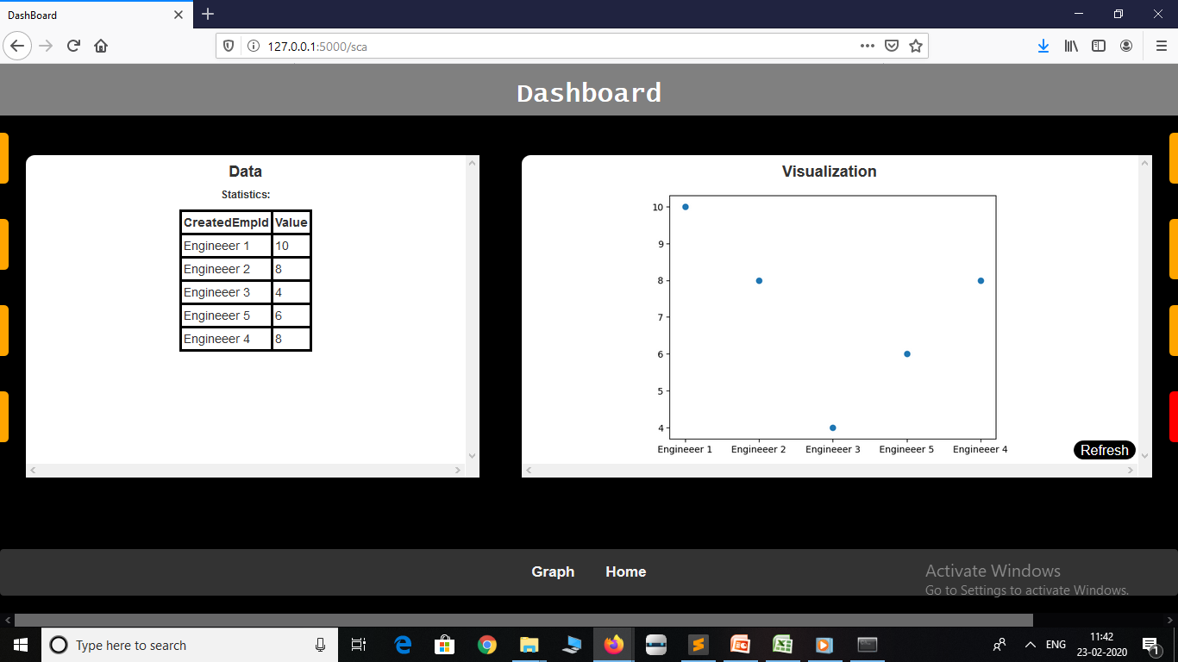
Dashboard Page -> Scatter Plot Visualization

Slide 21
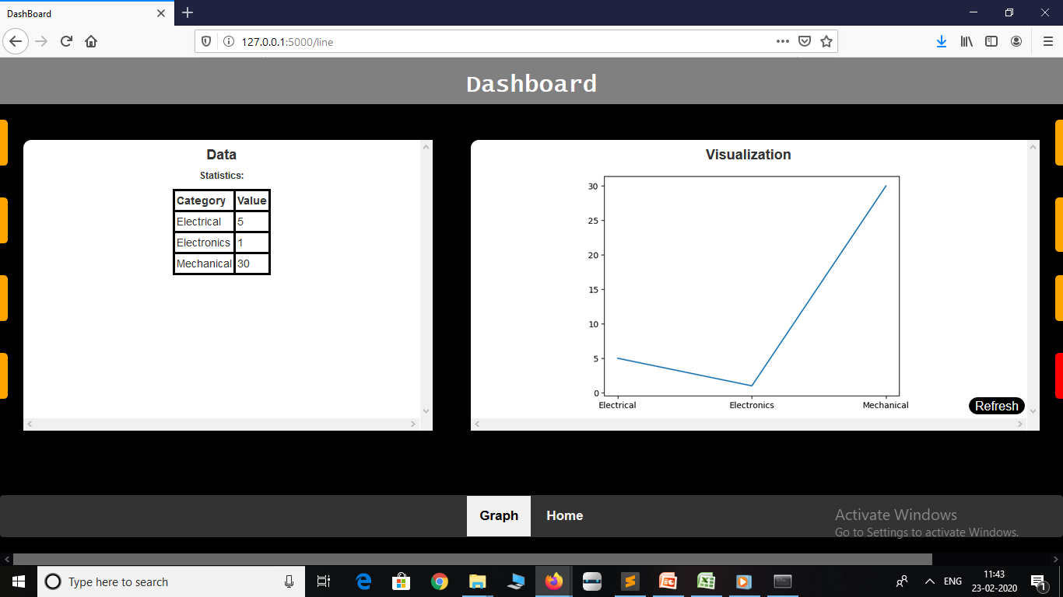
Dashboard Page -> Line Plot Visualization

Slide 22
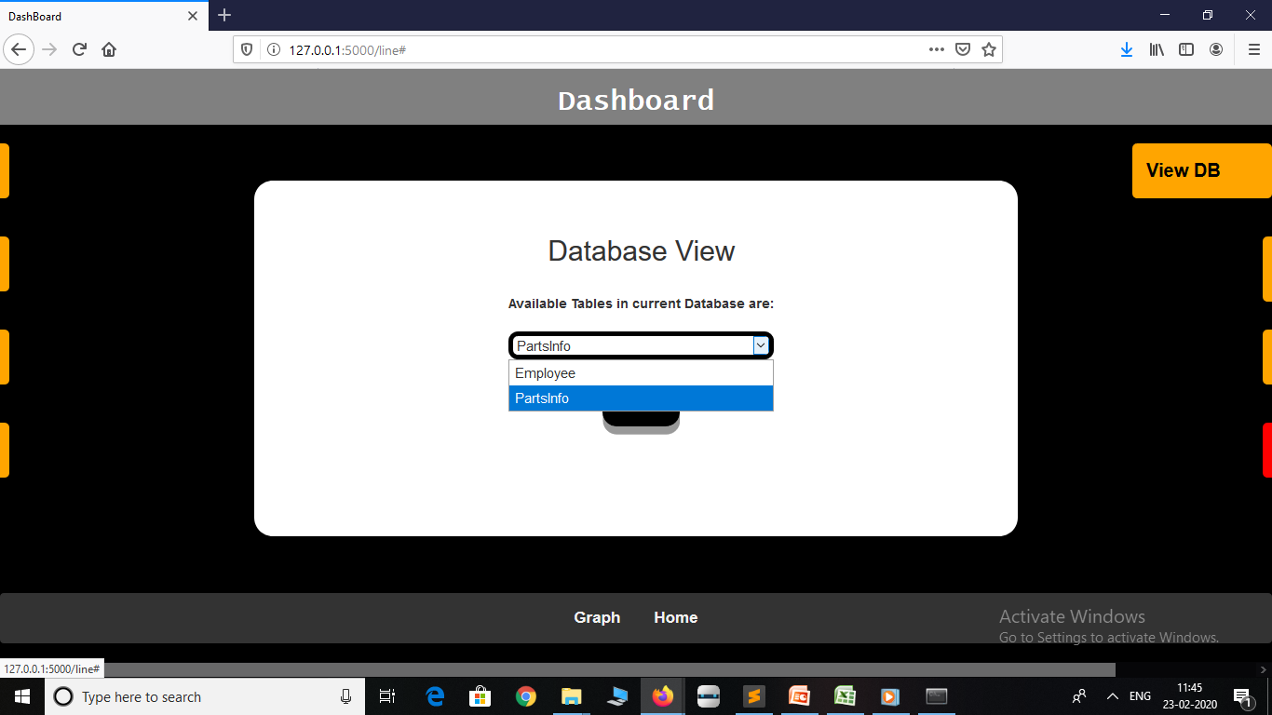
Dashboard Page -> Database View

Slide 23
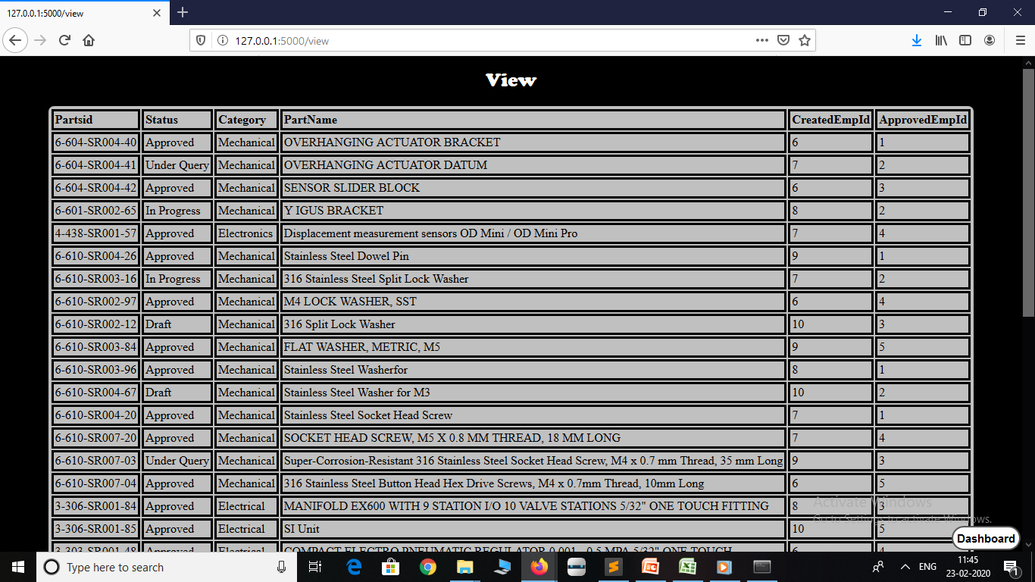
View Page -> Database Content View

Slide 24
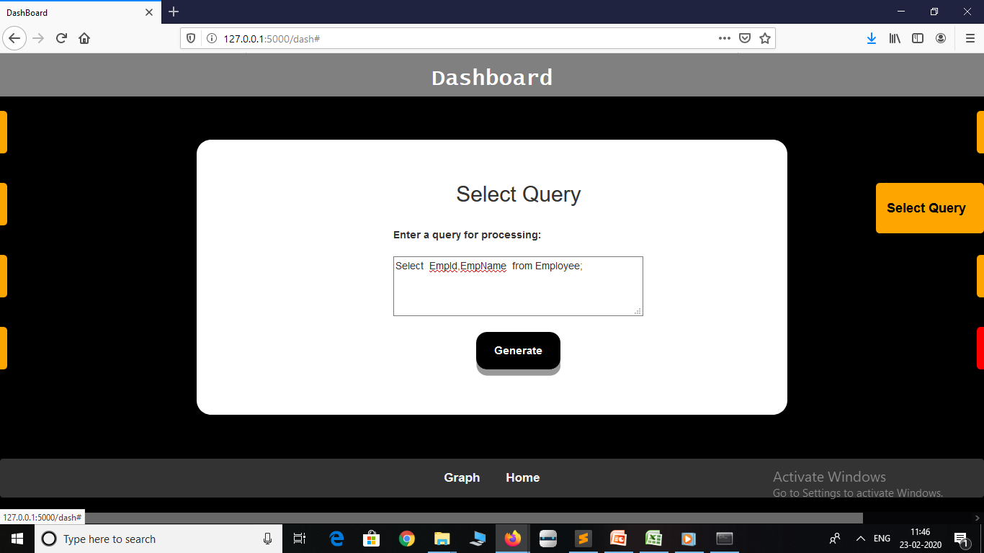
Dashboard Page -> Select Query

Slide 25
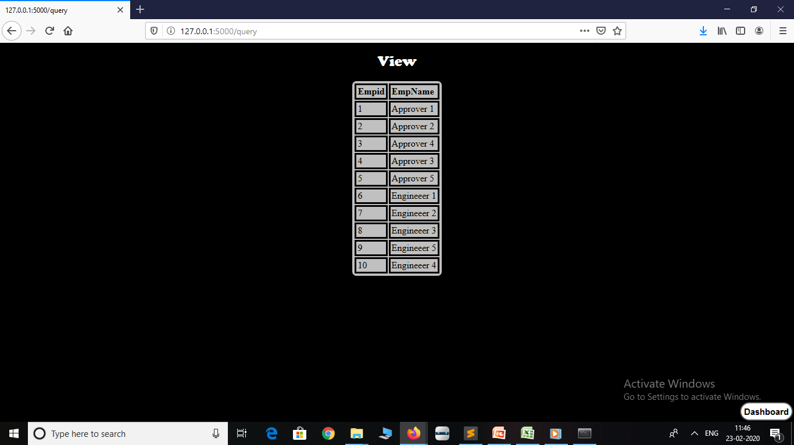
View Page -> View from user select query

Slide 26
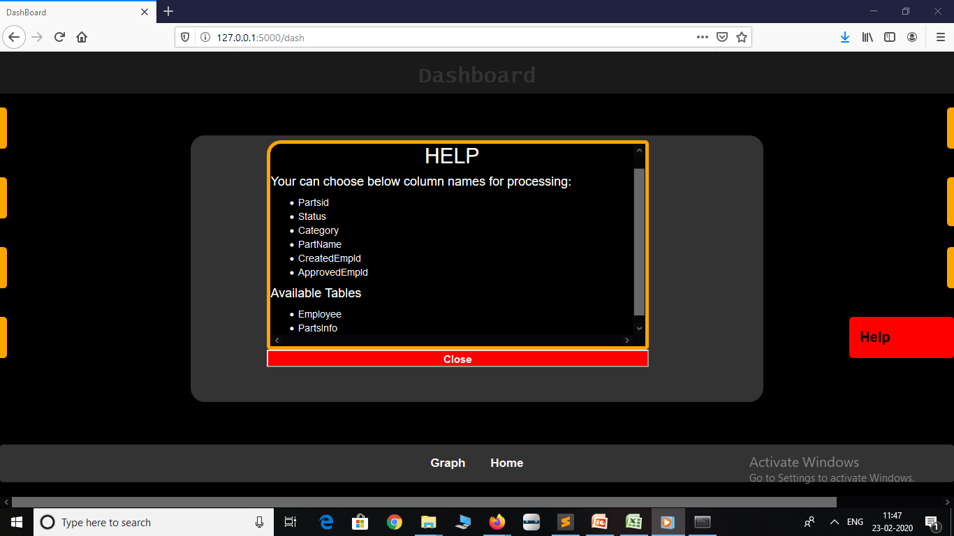
Dashboard Page -> Help

Slide 27
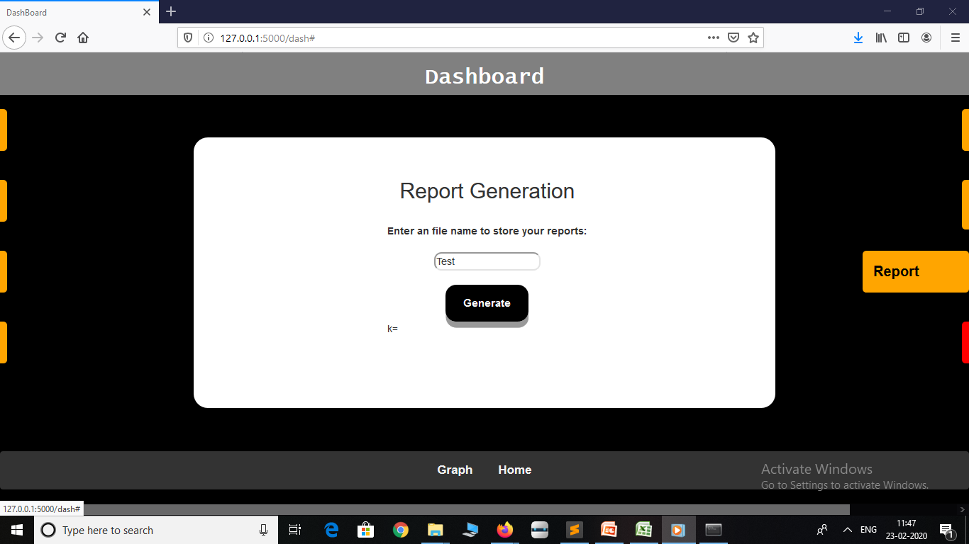
Dashboard Page -> Report Generation

Slide 28
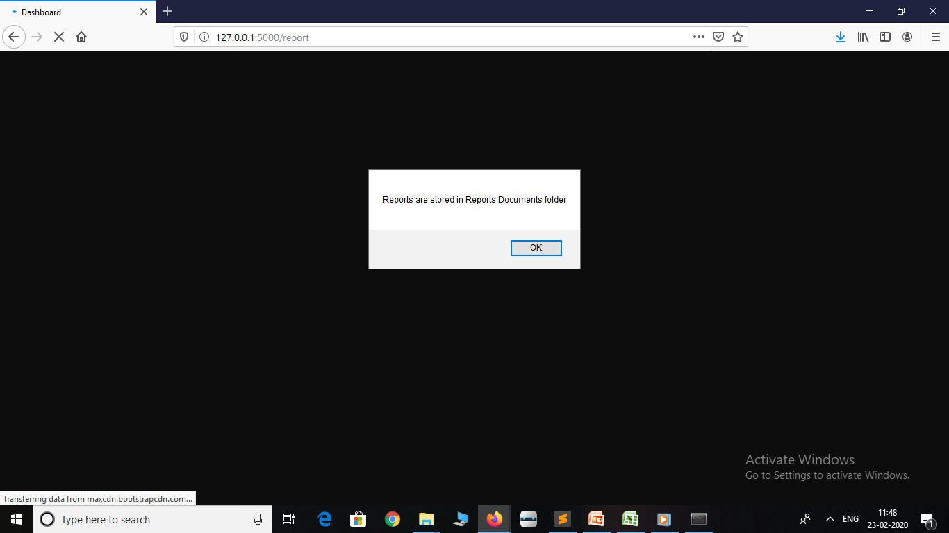
Dashboard Page -> Alert if report generation is success

Slide 29
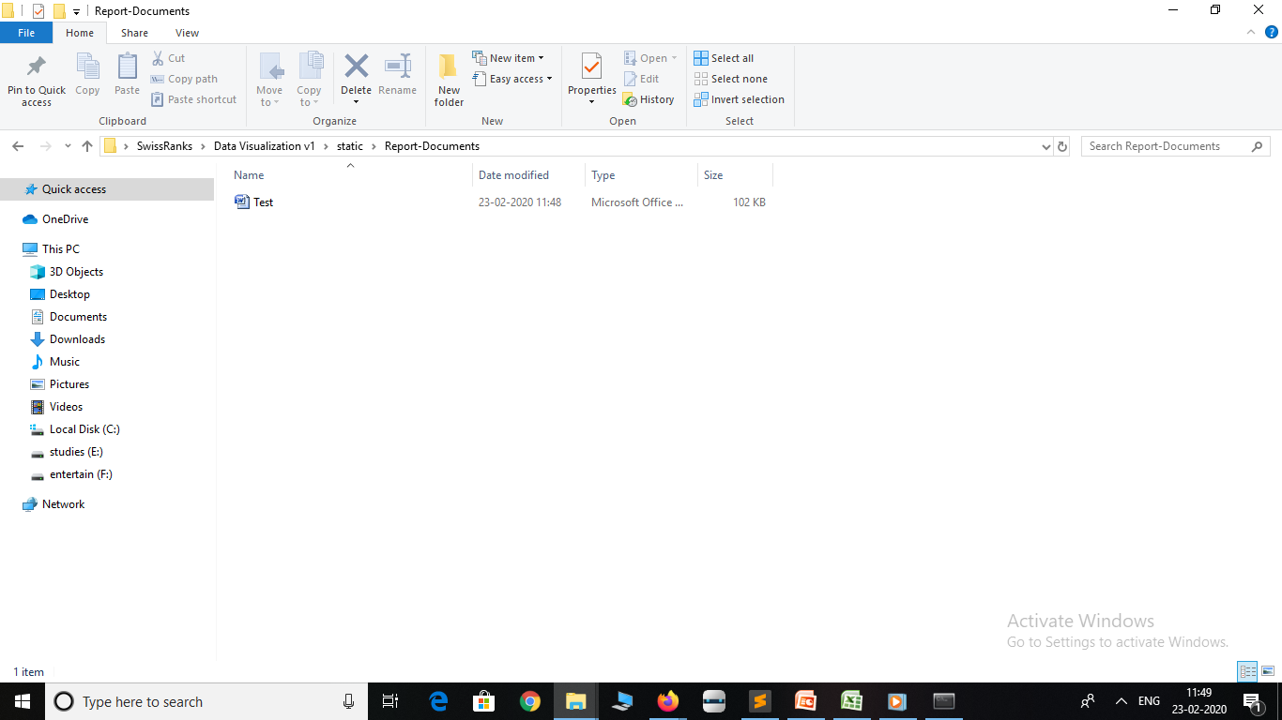
Generated report[.docx] in Report Documents

Slide 30
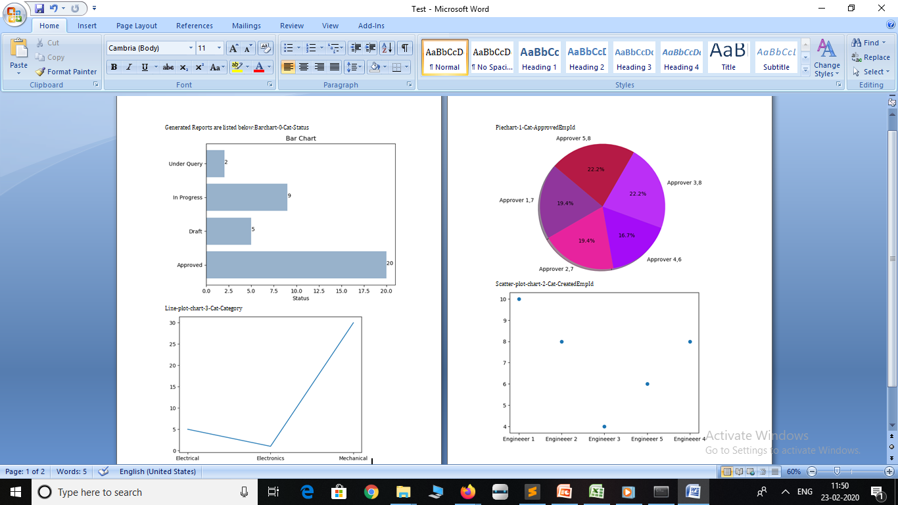
Contents of Generated Report [from Test.docx]

Slide 31

Zip file created from generated charts(Graphs)

Slide 32
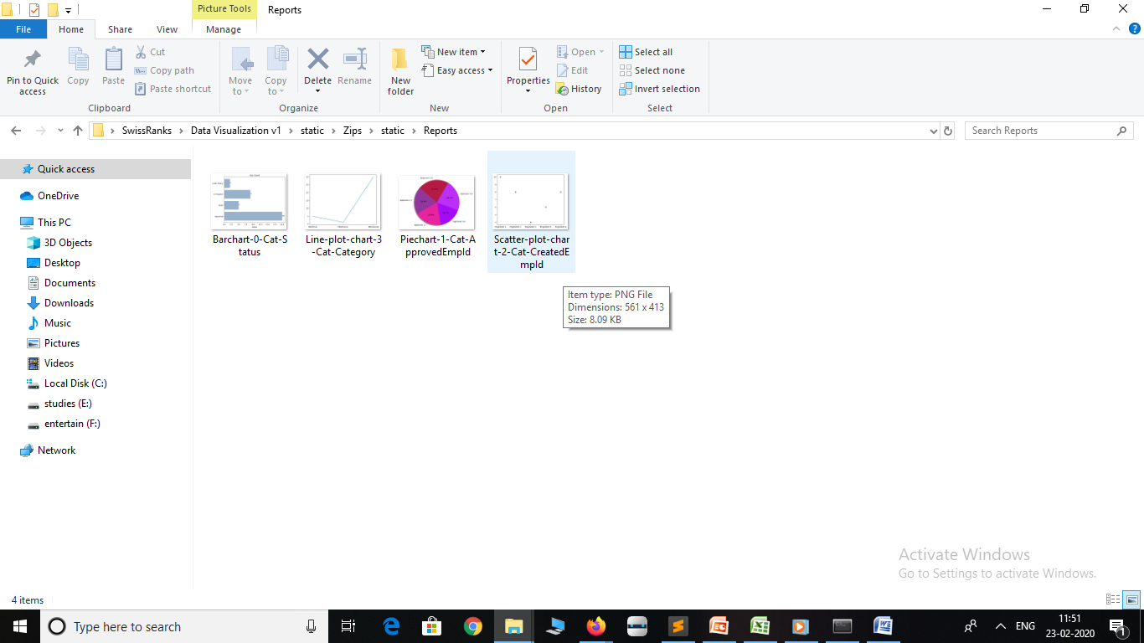
Extracting Zip file gives all individual charts[generated] in .png from

Slide 33
Challenges Faced
Various issues arose during normalizing given table, including
Extracting unique Approver/rejecter and Creator and inserting them into new table.
Joining 2 table in order to obtain required /Expected result.
Confused during selection of Department for Employee because individual Engineer or Approver involved in all categories(Mechanical & Electrical)

Slide 34
Challenges Faced
Other issues including
Issues raised in displaying Charts in HTML obtained from Python Matplot Library.
Selecting the document type in which Report needed to be generated and file name for each (individual) reports.
Returning multiple values obtained from a query to HTML file for View.

Slide 35
Thank You

